Slide 1


Slide 2


Traffic Sense AI
Project Presentation
Submitted by
ROLL Number | Name And Contributions
2401010025 2401010102 | Nakul Arora (Model Training) Vansh Tanwar (Model Accuracy)
2401010099 2401010104 | Utkarsh Singh (Dataset Cleaning) Rahul Kumar ( Built User Interface)
2401010092 | Vivek Mandal (API Link)
2401010053 | Faiz Khan (Collect Dataset)
Faculty Mentor: DR. REENU MA’AM
Notes:
New Courses replaced with New Programmes

Slide 3
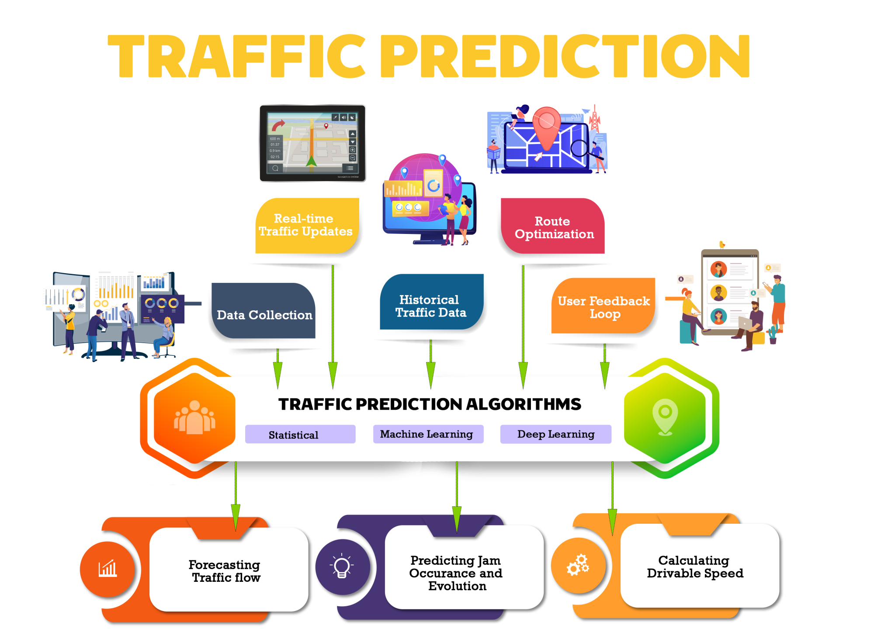

Project Overview
TrafficSense AI is an intelligent system designed to predict traffic congestion levels using Machine Learning.
It uses a Random Forest Classifier to analyze:
Time of day
Day of week
Vehicle counts
The system also provides:
Interactive web interface (Streamlit)
Real-time route visualization using OpenStreetMap
Notes:
New Courses replaced with New Programmes

Slide 4
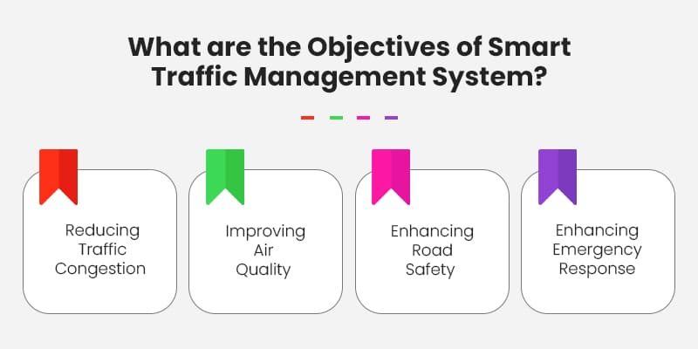
Specific Objectives
Predict traffic congestion levels accurately
Enable route visualization on maps
Support smart city traffic planning
Improve travel decision-making
Notes:
New Courses replaced with New Programmes

Slide 5
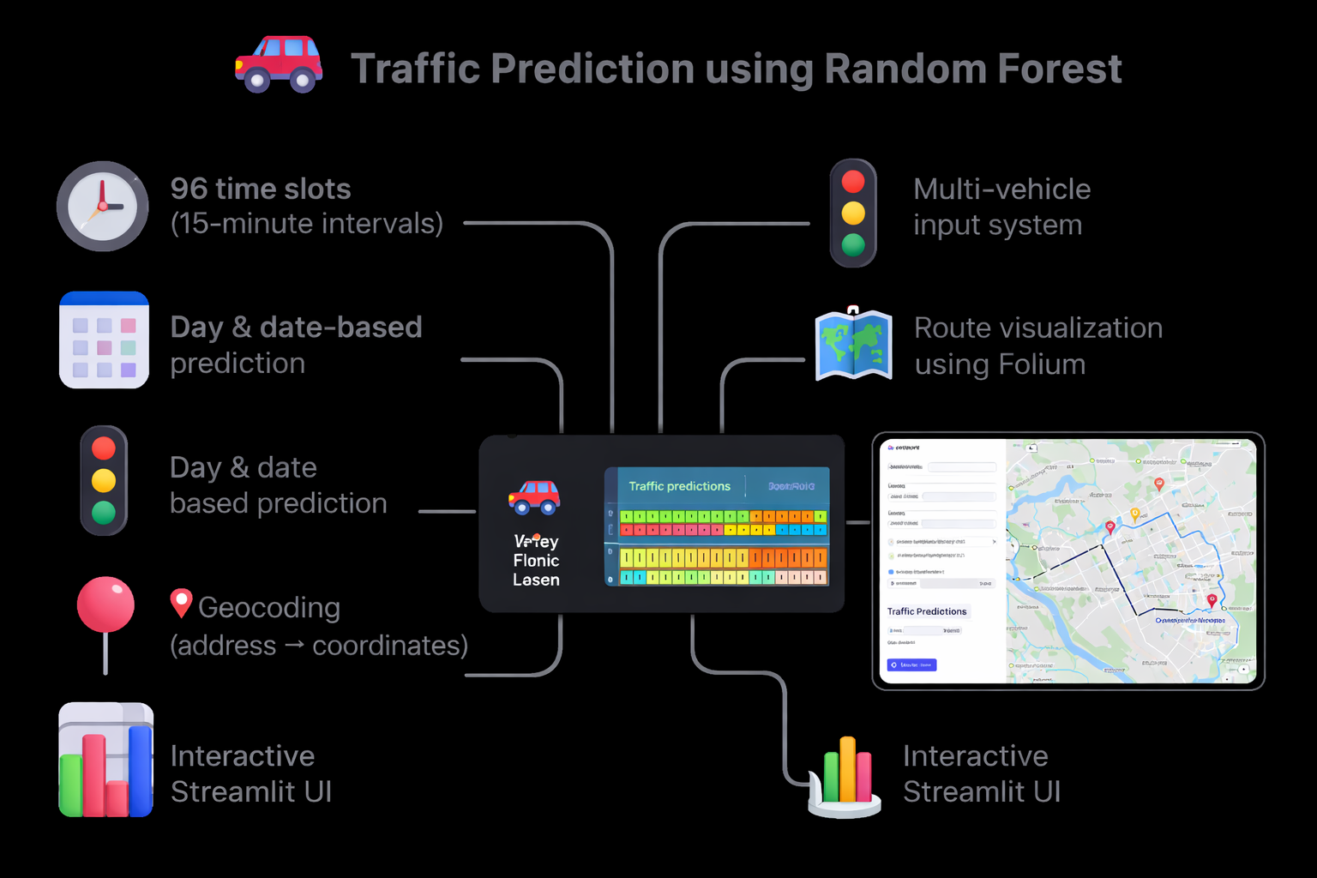
Key Features
🚗 Traffic prediction using Random Forest
🕒 96 time slots (15-minute intervals)
📅 Day & date-based prediction
🚦 Multi-vehicle input system
🗺️ Route visualization using Folium
📍 Geocoding (address → coordinates)
📊 Interactive Streamlit UI
Notes:
New Courses replaced with New Programmes

Slide 6
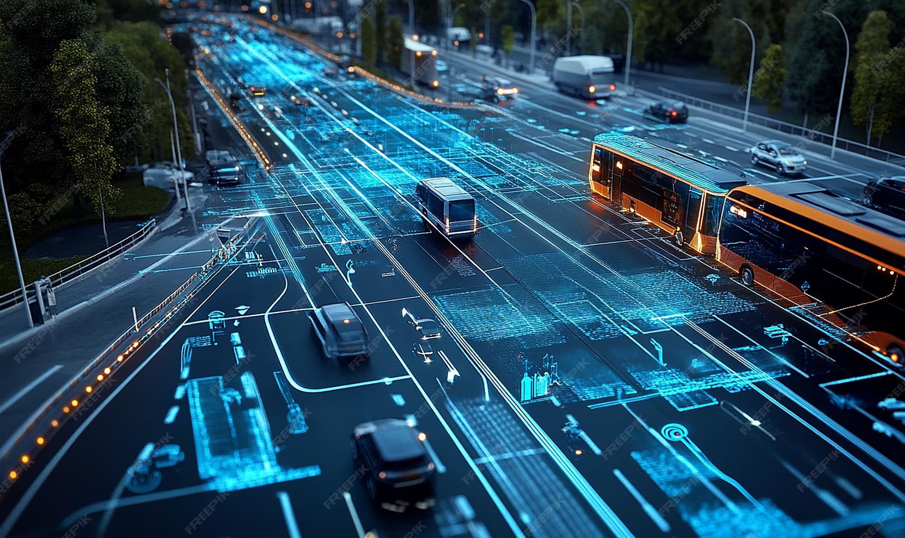
Project Usecases & Scope
Smart city traffic monitoring
Route planning & navigation
Logistics & delivery optimization
Urban infrastructure planning
Congestion forecasting
Notes:
New Courses replaced with New Programmes

Slide 7
Architecture
User Input
↓
Data Encoding
↓
Random Forest Prediction
↓
Route Fetch (OSRM API)
↓
Map Visualization (OpenStreetMap + Folium)
Notes:
New Courses replaced with New Programmes

Slide 8
Data & Resources
Dataset: traffic_dataset.csv
Libraries: NumPy, Scikit-learn
Tools: Streamlit, Folium
APIs: OpenStreetMap + OSRM
Model Storage: Pickle
Notes:
New Courses replaced with New Programmes

Slide 9
Methodology
Data collection from dataset
Data cleaning (remove null & duplicates)
Feature selection (time, vehicles, date)
Data splitting (80% training, 20% testing)
Model training using Random Forest
Model evaluation
Deployment using Streamlit
Notes:
New Courses replaced with New Programmes

Slide 10

Machine Learning Model
Algorithm: Random Forest Classifier
Reasons for selection:
Works well with structured data
High accuracy
Reduces overfitting
Easy to interpret
Output Classes:
🟢 Low
🟡 Medium
🔴 Very High

Slide 11
Expected Results & Impact
Accurate congestion prediction
Better route planning
Reduced travel time
Improved traffic management
Supports smart city initiatives
Notes:
New Courses replaced with New Programmes

Slide 12
Project Timeline
Phases of the project with estimated timeframes
Flow chart or simple timeline format
Week 1–2 : Planning & Data Collection
Week 3–4 : Data Cleaning & Analysis
Week 5–6 : Feature Selection & Model Training
Week 7–8 : Evaluation & Deployment
Week 9–10: UI Development & Documentation
Notes:
New Courses replaced with New Programmes

Slide 13
THANK YOU

